Slide 1
Building Capacity with Faculty Fellows for Data and Assessment
Areeje Zufari, Faculty Fellow for Data and Assessment
Nichole Fehrenbach, Director, Learning Assessment

Slide 2
Presenters
Areeje Zufari - Faculty Fellow for Data and Assessment
Professor of Humanities, Valencia College
Nichole Fehrenbach - Director of Faculty Fellows for Data and Assessment
Director, Learning Assessment, Academic Affairs, Valencia College
We will each be playing our roles as Fellow or Director of Fellows,
We will respond as possible in the chat.
On slides when you see this, feel free to…
Unmute to share your thoughts

Slide 3
Valencia College - students

Slide 4
Valencia College - 7 campuses + schools and training facilities

Slide 5
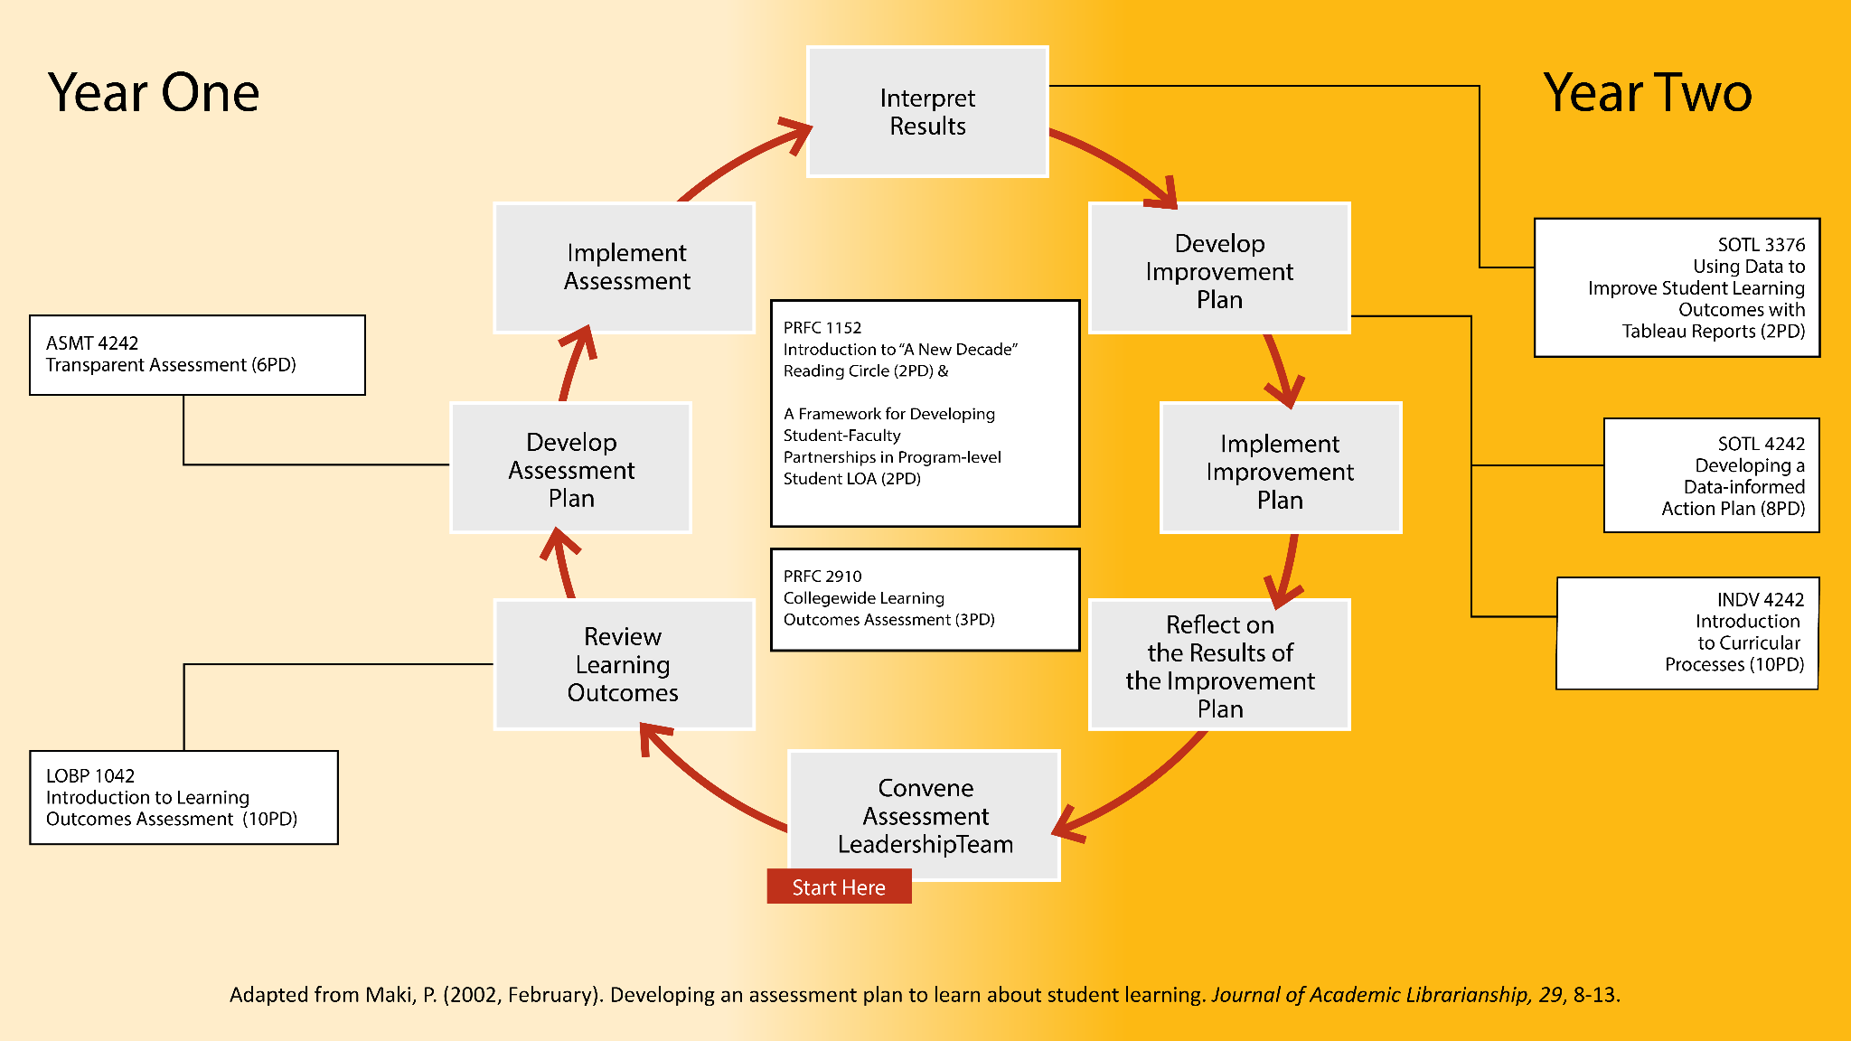

Slide 6
Valencia College's Faculty Fellows
Structured program that engages faculty professionally:
Through scholarship and innovation
With skills in data analysis and assessment
To become assessment leaders on campus

Slide 7
The Role of the Faculty Fellow
Unmute to share your thoughts
Faculty Fellows for Data and Assessment are out-of-discipline members of multiple Assessment Leadership Teams who:
• support writing measurable learning outcomes and indicators;
• advise development and implementation of meaningful assessment;
• support analysis and interpretation of results;
• support development of feasible improvement plans;
• support facilitation of meetings.

Slide 8
Activity: Faculty Fellow Development
Role 1: Standard Assessments-
Why can’t we just do what we did before, so it is all the same?
This feels like extra work (to me, or to a colleague I’m advocating for)!
Role 2: Context of the Course -
Can’t we all agree on a good rubric?
We each want to do our own thing!
Role 3: This is not feasible -
What if faculty don’t submit the data?
We couldn’t possibly collect this data!

Slide 9
Lessons Learned
Conflict resolution
Balancing broad flexibility
Having some standard procedures and timelines
Cohort style, fellowship since we do not all have the same skills
Ongoing, cycles of development

Slide 10
Unmute to share your thoughts
How do you envision engaging faculty?
Could an assessment role like this be beneficial at your institution?
What else do you want to know from us?

